Slide 1
Weekly report: Team Project Development
Week number: 01
Date: 30/09/2025
Supervisor: Dr. Marina Blohm
Group members: Luis Urhahn, Ahmed Sallam, Ceren Cetin, Sohail Mansuri

Slide 2
List of content
Task of the week
Site selection – our approach
Site update
Site comaprison
Site suggestion (Project Development Team)
Sila Ceren Cetin-770819

Slide 3
1. Tasks of the week
Initial task defined by last weeks meeting + Mrs Blohm:
Define the final site for our project and explain why we choose the site.
New task due to updates during the week:
Comparing the new (official) sites for wind energy in Syria and decide if possibly better…
Sila Ceren Cetin-770819

Slide 4
2. Site selection – Our approach
I. Self-study on the topic and the country of Syria​
​
II. Initial meeting with Mrs. Blohm​
Getting a sight about how to choose a location.​
​
III. Searching for possible areas, considering…​
​
IV. Comparison of suitable areas​
Pros/Cons List for comparison​
Final decision on one area​
​
V. Finding a suitable/available site in the area​
​
VI. Confirmation meeting with Mrs. Blohm
Sila Ceren Cetin-770819

Slide 5
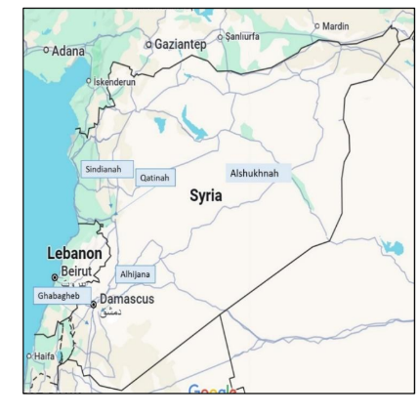
3. Site update
Getting a mail from Dr. Alhrshy about Request for Qualification (RFQ) issued by the Syrian Ministry of Energy / PETDE for a 100–200 MW Wind Farm Project in Syria.
Proposed Sites
Site 1: Qatinah Site – A flat open area
Site 2: Sindianah Site – A hilly open area
Site 3: Alhijana Site – An open desert area
Site 4: Ghabagheb Site – A hilly open area
Site 5: Alsukhnah Site – A high, open, and flat desert area
[1]
Sila Ceren Cetin-770819

Slide 6
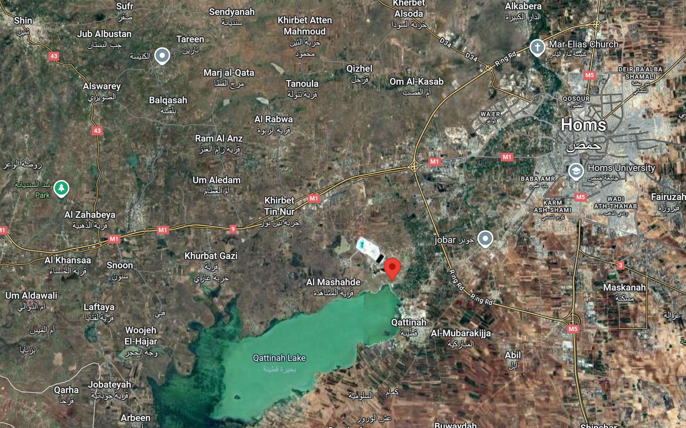
3. Site update - Qattinah
Initial location
New location
[2]
Sila Ceren Cetin-770819

Slide 7
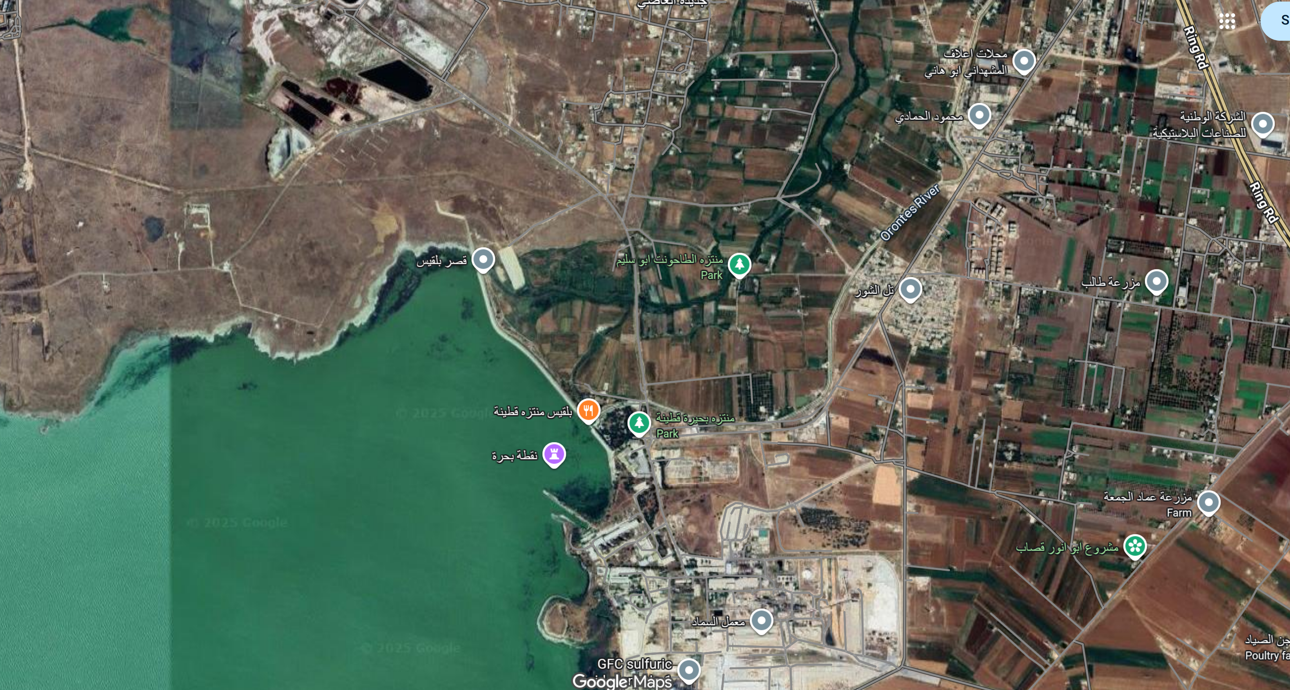
3. Site update - Qattinah
Substation
[2]
Sila Ceren Cetin-770819

Slide 8
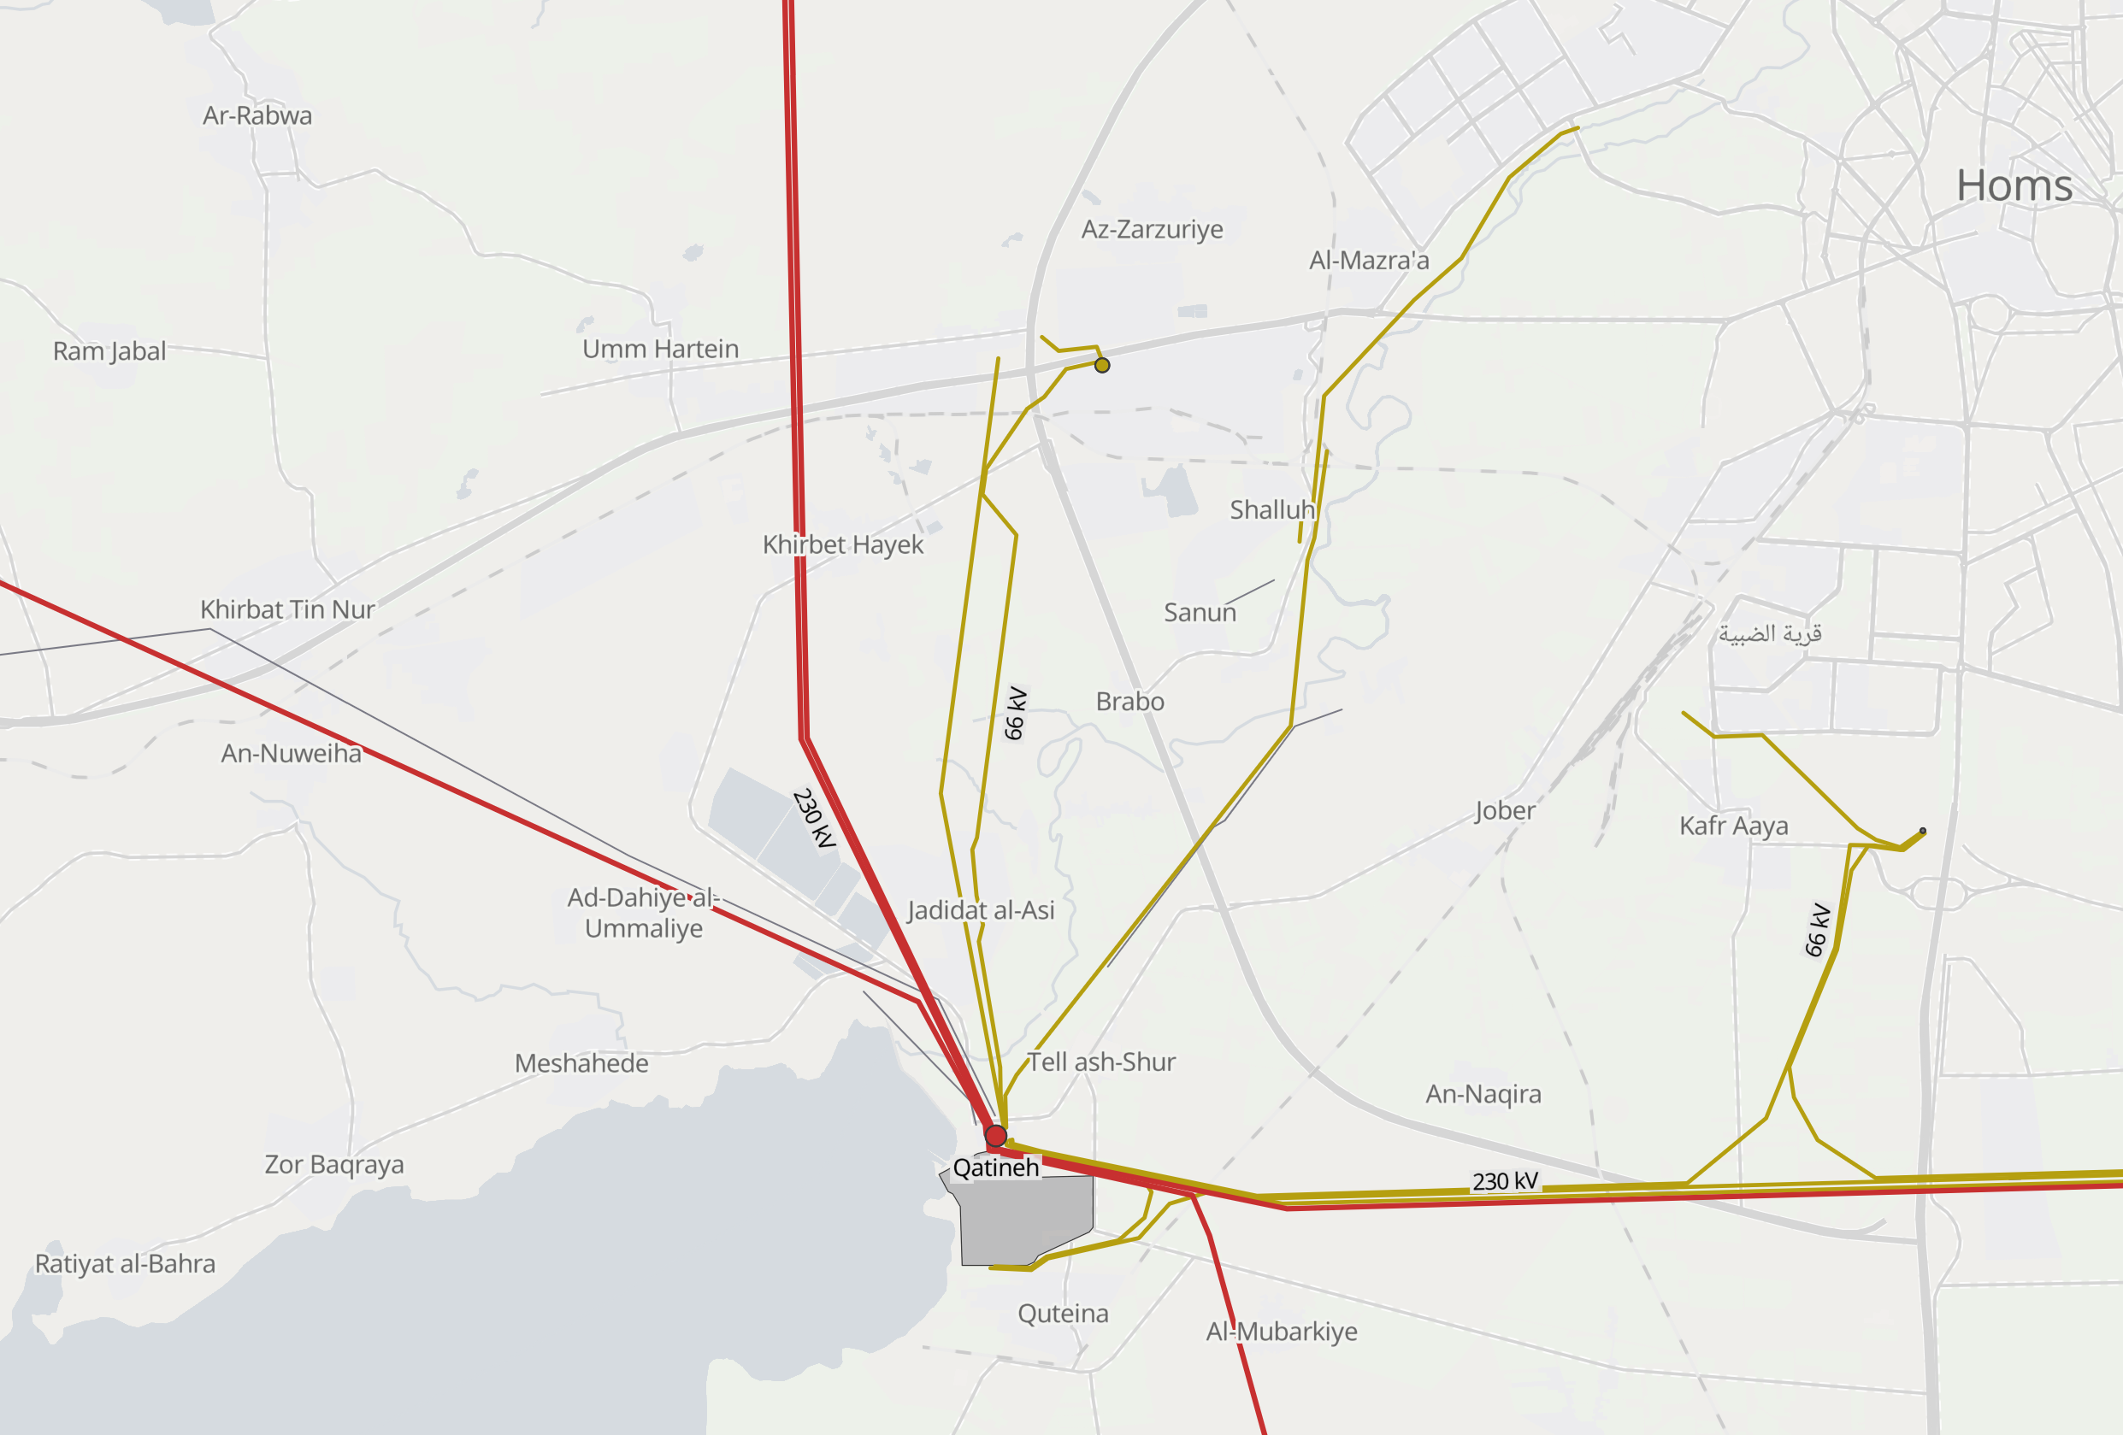
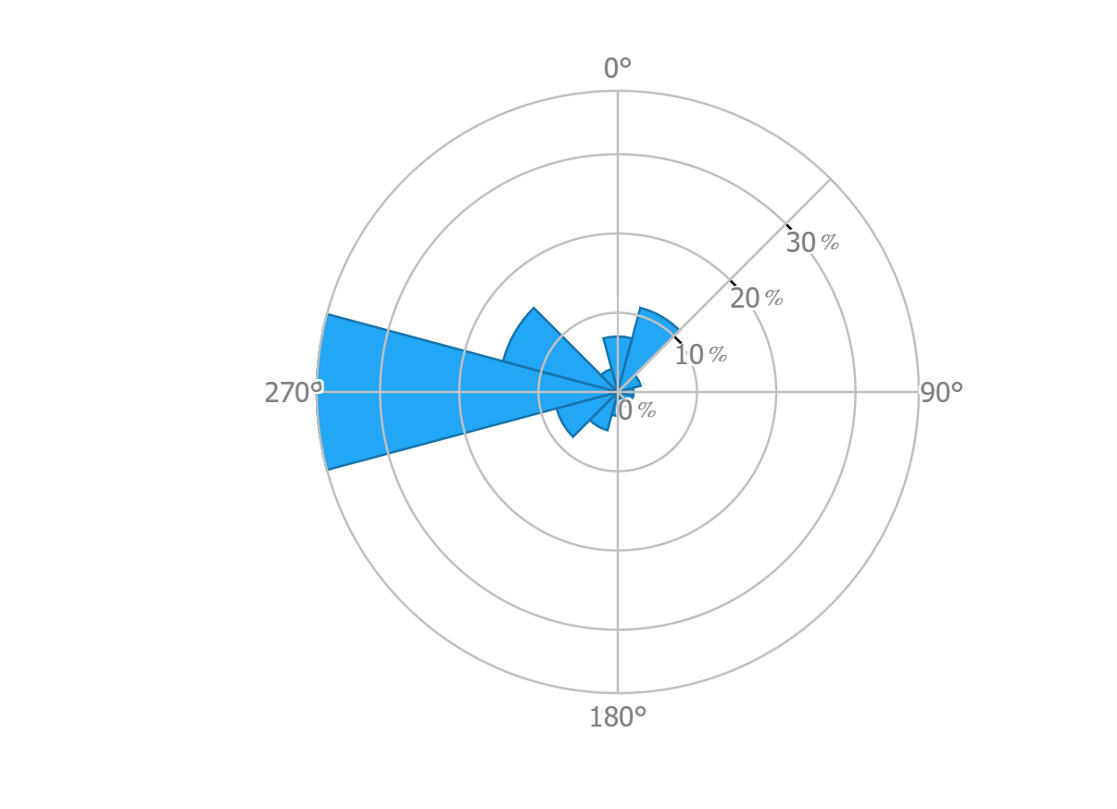
3. Site update - Qattinah
Wind Resource Data (at 100m HH) | Grid Connection
Main wind direction: 270° (west) | Grid connection: 66 kV and 230 kV
Average wind speed: 7.69 m/s | Distance to substation: < 5 km
Wind turbine class: III A | Distance to industry: < 15 km
Turbulence intensity: A
[1]
Sila Ceren Cetin-770819

Slide 9
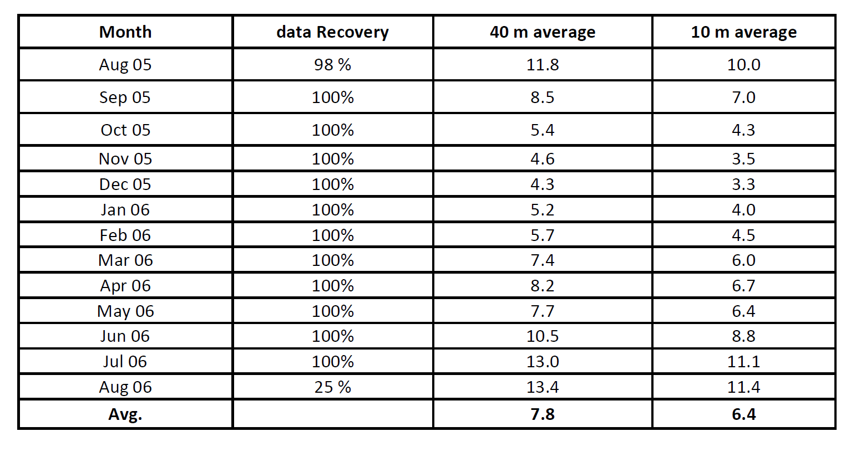
3. Site update - Qattinah
Wind resource data:
[1]
Sila Ceren Cetin-770819

Slide 10
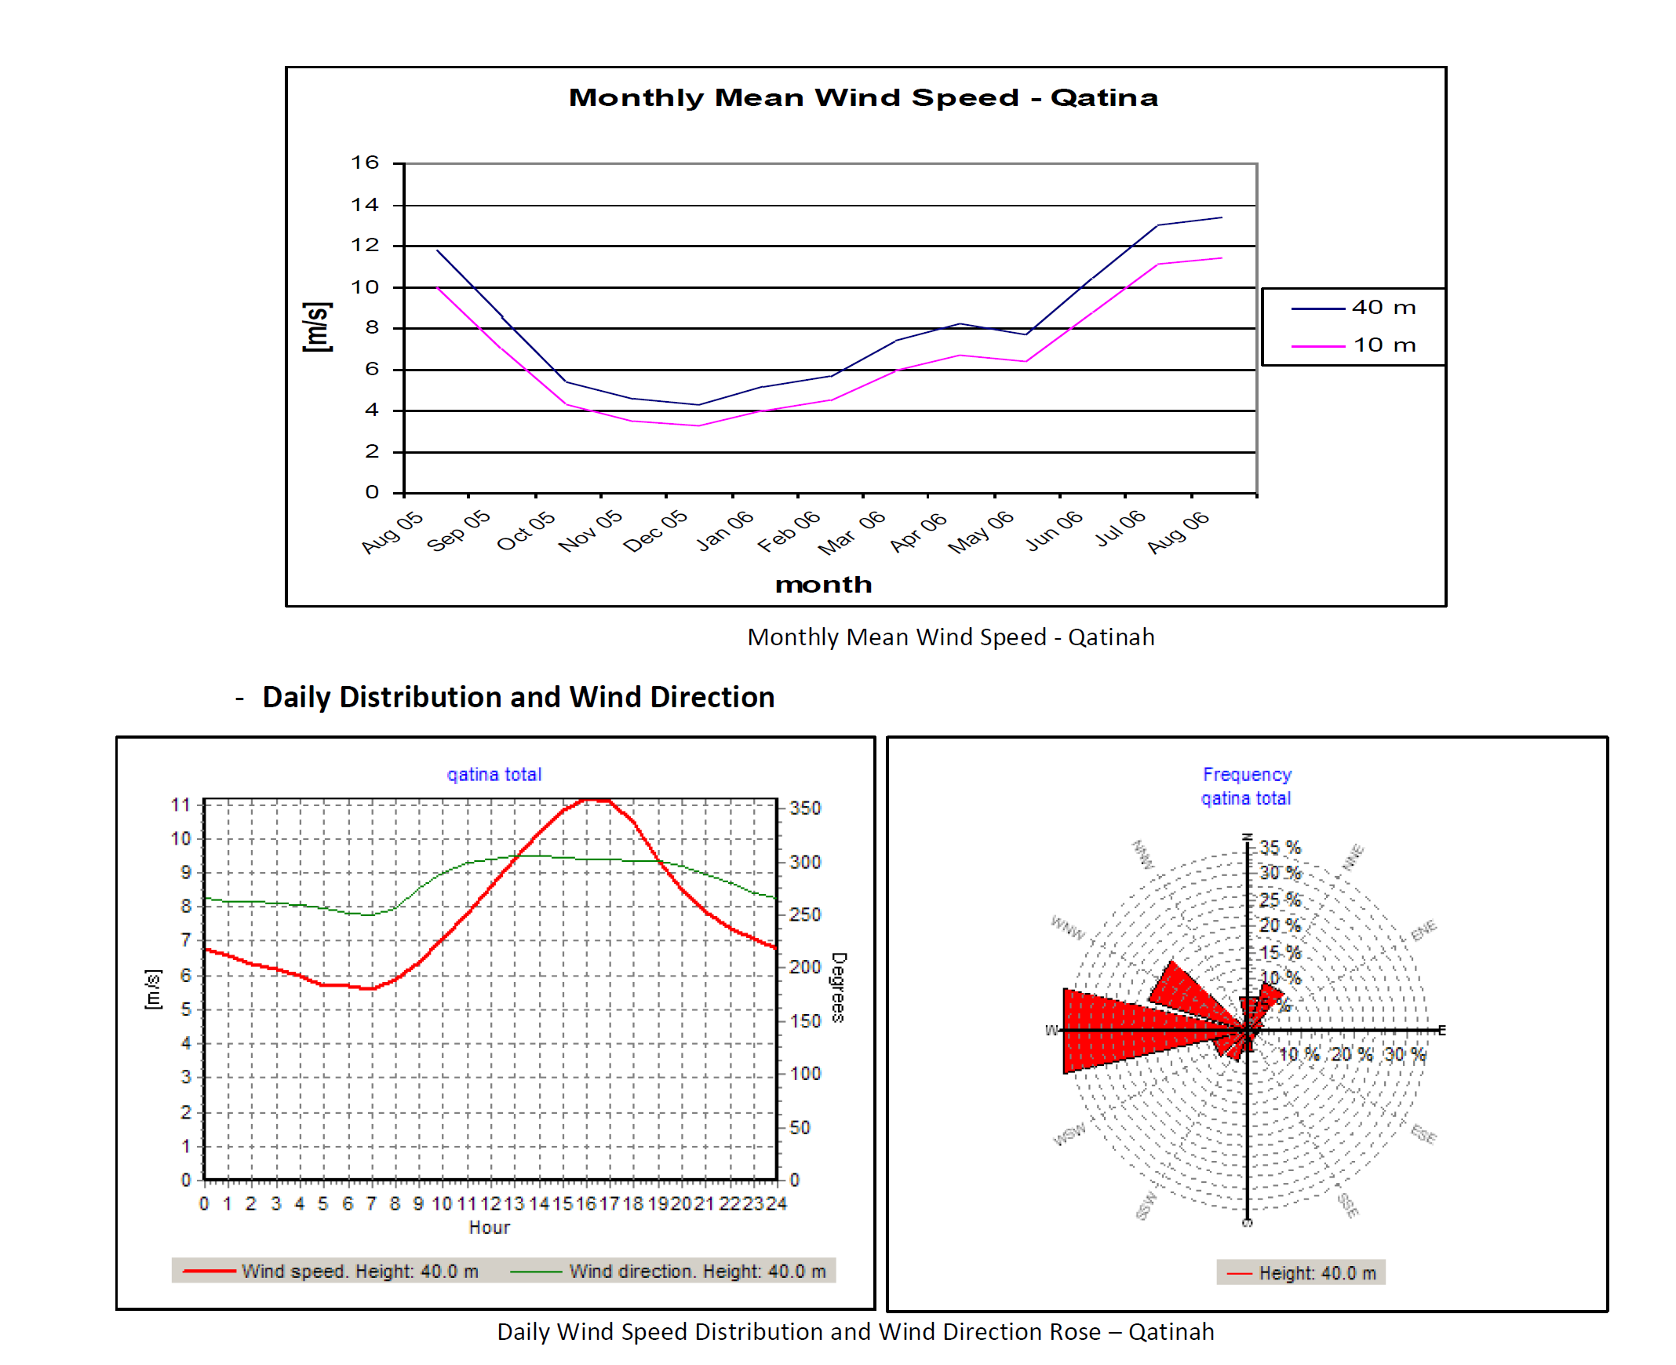
3. Site update - Qattinah
Wind resource data:
[1]
Sila Ceren Cetin-770819

Slide 11
3. Site update - Qattinah
Pros | Cons
+ Good wind conditions | - Complex transportation way, new street needed
+ 90% Wind direction from west (270°) | - Street conditions unknown
+ Tendered area, official area for wind energy | - Small bridges to the location
+ Relatively close to the highway M1 | - Very close to buildings, especially in main wind direction
+ Close to the city of Homs (Industry) | - Windspeed slightly smaller than site of Um Aledam
+ Good connection to the port of Tartus
+ Perfect grid connection (66 kV and 230 kV Grid)
+ Existing Substation within 5 km
+ Very flat terrain due to lake (no big turbulences)
→ The project can utilize the state-owned land within elevation levels 500–501 m A.S.L. Additional expansion is
possible by agreement with private landowners in the area.
[1]
Sila Ceren Cetin-770819

Slide 12
4. Site comparison
 | Um Aledam | Qattinah
Main wind direction: | 270° (West) | 270° (west)
Average wind speed: | 9.29 m/s | 7.69 m/s
Wind turbine class: | III A | III A
Distance to substation: | 10 km | 5 km
Grid connection: | 66 kV Substation | 66 kV and 230 kV
Distance to industry: | 20 km | < 15 km
[3]
Sila Ceren Cetin-770819

Slide 13
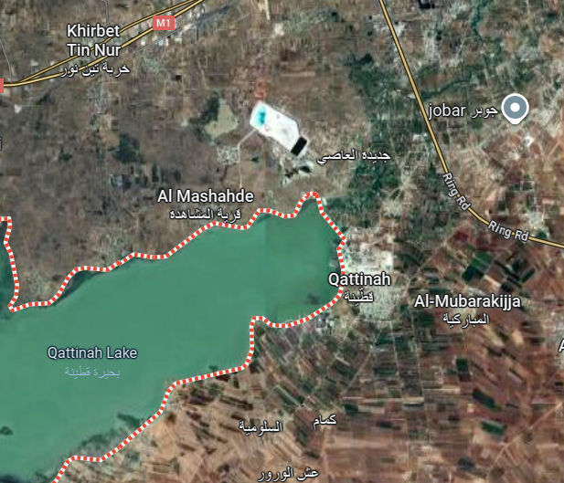
4. Site suggestion
We suggest : Qattinah
Because of:
It is officially tendered loacation.
Since a feasibility research aldreaz done.
The wind condition is worse but still good to build a wind turbine.
Possibility to build a wind farm.
[1]
Sila Ceren Cetin-770819

Slide 14
Bibliography – team name
[1] Syrian Arab Republic, Ministry of Energy, Public Establishment for Transmission & Distribution of Electricity (PETDE), Request for Qualification (RFQ) for Developers/Sponsors of 100–200 MW Wind Farm Independent Power Producer (IPP) Project, RFQ Document No. 2/2025, Damascus, Syria, 2025.
[2] Google, Google Maps. [Online]. Available: https://maps.google.com
[3] DTU Wind and World Bank Group, Global Wind Atlas, 2025. [Online]. Available: https://globalwindatlas.info
Sila Ceren Cetin-770819

